Slide 1

Capstone
By: Trevor Hicks

Slide 2

Can a video game satisfy your sweet tooth and your need for speed?
"Candy Rush Grand Prix"
A candy-themed go-kart racing game inspired by Diddy Kong Racing.
Players race through whimsical, sugar-filled environments, navigating tracks made of chocolate, licorice, and other sweets. The game features colorful karts, candy power-ups, and fun, competitive gameplay, perfect for players of all ages.

Slide 3

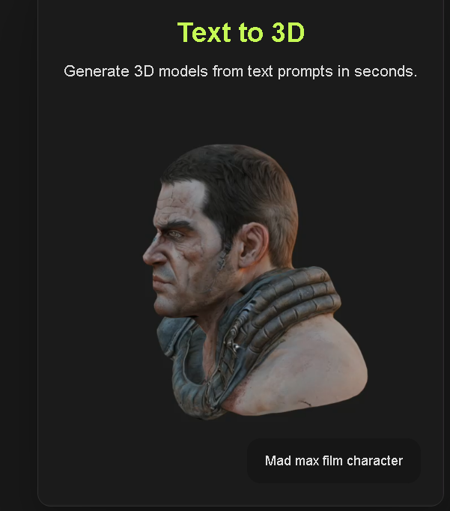

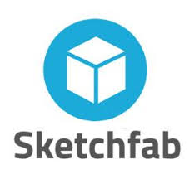


What I used?

Slide 4

Demo

Slide 5

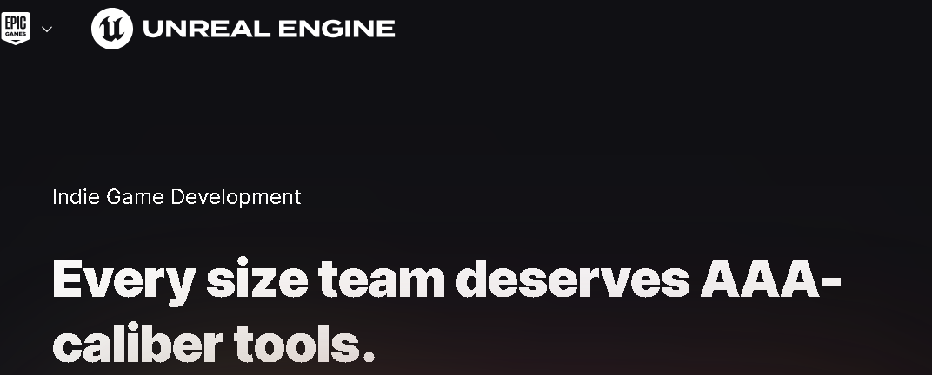
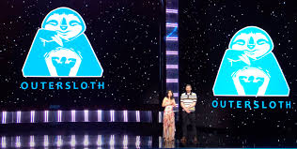
Future Plans
More Items
Bring back Battle Arena’s and secret track routes
Multiplayer / Couch Co-op
More Themed Tracks / Special Tracks during holiday times
More Customization to karts
Character Creation

